Slide 1

AKS Well-Architected Assessment
<customer name>
<name>
Date: <date>

Slide 2
Agenda
Introduction You learn about the solution,
we learn about you
Recommendations Proposed tasks and activities to
improve your AKS Farm
Next Steps Decide how we’re going to
complete the work
AKS Well-Architected Assessment
Overview
Outcomes
Proposed activities and timeline

Slide 3
Introduction
AKS Well-Architected Assessment Outcomes

Slide 4
Kubernetes statistics
According to a forecast by Research and Markets, the global Kubernetes market is expected to experience remarkable growth, projected to increase from USD 1.8 billion in 2022 to USD 7.8 billion by 2030, exhibiting an impressive Compound Annual Growth Rate (CAGR) of 23.40% during the forecast period.
Over 50% percent of Fortune 100 companies have adopted Kubernetes, making it the container orchestration platform of preference in the enterprise.
More than 2,500,000 commits have been made to the Kubernetes GitHub repositories, demonstrating the community's extensive collaboration and commitment to continuous enhancement.
According to a recent survey, 78% of Kubernetes clusters have medium to high-security concerns, highlighting the urgent need for strong security procedures.
AKS maintains a 28% adoption rate among businesses with 5,000 or more employees.

Slide 5
Kubernetes: the de facto orchestrator
Portable
Public, private, hybrid, multi-cloud
Microsoft investing in Kubernetes
88%
of enterprises using or adopting Kubernetes
Extensible
Modular, pluggable, hookable, composable
74% of enterprises that use Kubernetes are running workloads in production
74% of survey respondents have a DevSecOps initiative underway
At least 20% of enterprises that use Kubernetes leverage six different open-source security tools
Self-healing
Auto-placement, auto-restart, auto-replication, auto-scaling
All statistics from Red Hat. “Kubernetes adoption, security, and market trends report 2021.” July 14, 2021. Report.

Slide 6

AKS Well-Architected Assessment
Kubernetes and its Azure implementation has become a market standard for deploying modern cloud-oriented microservice applications.
The purpose of the assessment is to verify that Microsoft good practices are applied to prevent security or reliability problems from compromising compliance with the service level agreements guaranteed by the hosted applications in the future.
Refs: Best practices for Azure Kubernetes Service (AKS) - Azure Kubernetes Service | Microsoft Learn Azure Well-Architected Framework review for Azure Kubernetes Service (AKS) - Microsoft Azure Well-Architected Framework | Microsoft Learn

Slide 7

Checks
Security:
Cluster must be private
NSG should be linked to node pools subnets
External IP addresses should not be associated with AKS load balancer
Network policies (Azure or Calico) should be enabled
Public FQDN should be disabled
Defender profile should be enabled
Policy add-on should be enabled
KMS should be enabled
RBAC should be enabled
AAD authentication should be enabled
Workload Identity should be enabled
Observability:
Container Insights should be enabled
Diagnostic Settings should be enabled
Resiliency:
Availability zones should be used
Uptime SLA should be enabled
Control plane and node pools version should not be outdated
Cluster should have at least one system and one user node pool
AAD PodIdentity should not be used
Networking
Azure Overlay network should be used
Performance
Leverage Ephemeral OS Disk

Slide 8
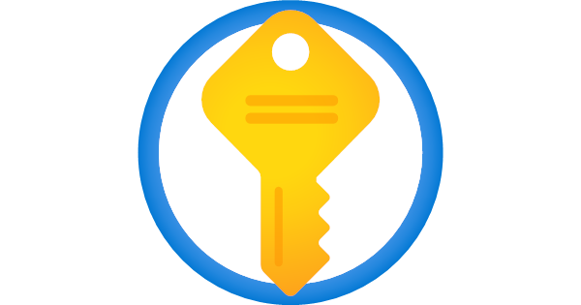
Subscriptions assessed
We have analysed <n> clusters in the following <m> subscriptions
Subscription AAA
Subscription BBB
Subscription DDD
Subscription EEE
Subscription FFF

Slide 9
AKS Assessment - Score
Overview of cluster score starting from 1 to 5
- Put here the score pivot chart

Slide 10
What is going well
Put here what is going well

Slide 11
Improvement Opportunities
Put here N P0, P1, P2 points of improvement

Slide 12
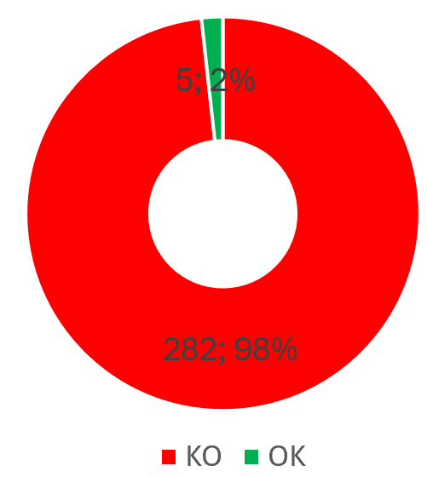
AKS Assessment – Cluster must be private
Benefits: -Ensure cluster management traffic to your API server and network traffic between your API server and your node pools remains on the private network only.
Actions:
If too risky, verify that your API Server implements IP restrictions
Recreate the cluster (evaluate AKS Backup)
Provision a JumpBox for cluster management operations
Provision a CI/CD self-hosted agent
Consider create clusters in private mode:
Create a private Azure Kubernetes Service (AKS) cluster - Azure Kubernetes Service | Microsoft Learn

Slide 13
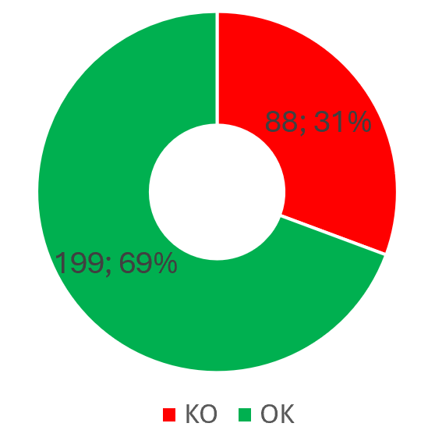
AKS Assessment – NSG should be linked to node pools subnets
Benefits: - Control Inbound/Outbound traffic for your Node pools
Actions:
Create the NSG
Associate it to the Node pools subnets
Configure the allow/deny rules
Create and associate a NSG to subnets:
AKS - Azure - Network security groups

Slide 14
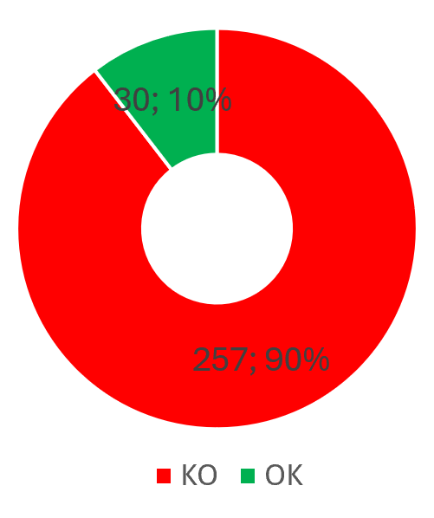
AKS Assessment – External IP addresses should not be associated with AKS load balancer
Benefits: - Application running in the cluster and exposed through a service are protected from internet access
Actions:
Switch the standard load balancer to an internal load balancer (??)
Use Azure Application Gateway to expose your applications configuring the internal load balancer IP as backend pool or enable Application Gateway ingress controller
Leverage the WAF Features
Consider using an internal load balancer:
Create an internal load balancer - Azure Kubernetes Service | Microsoft Learn

Slide 15
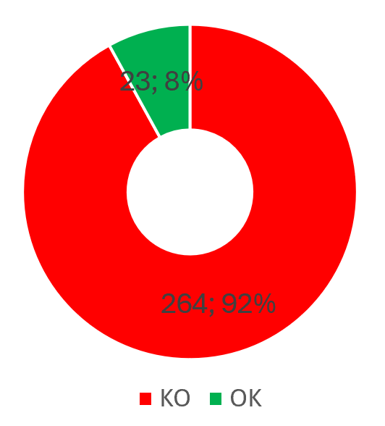
AKS Assessment – Network policies (Azure or Calico) should be enabled
Benefits: - Control communication between pods
- Improve security by reduces the attack surface and prevents unauthorized access to sensitive data or resources
Actions:
Recreate the cluster (evaluate AKS Backup)
Choose between Azure or Calico Network Policies
Design manifests for the allowed communication between pods
Package and deploy the manifests
Enable network policies:
Secure pod traffic with network policy - Azure Kubernetes Service | Microsoft Learn

Slide 16
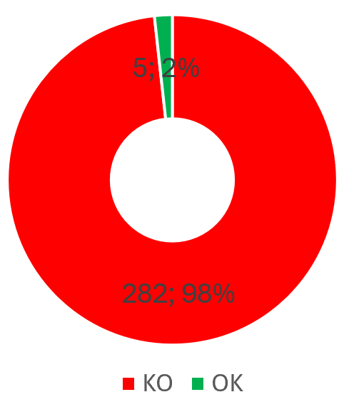
AKS Assessment – Public FQDN should be disabled
Benefits: - To be used with private clusters
- Limit the API Server name resolution to the VNET chosen for the private cluster and relative Private DNS zone
Actions:
Update the cluster configuration and disable Public FQND with the relative command
Disable Public FQDN:
Create a private Azure Kubernetes Service (AKS) cluster - Disable a public FQDN -Azure Kubernetes Service | Microsoft Learn

Slide 17
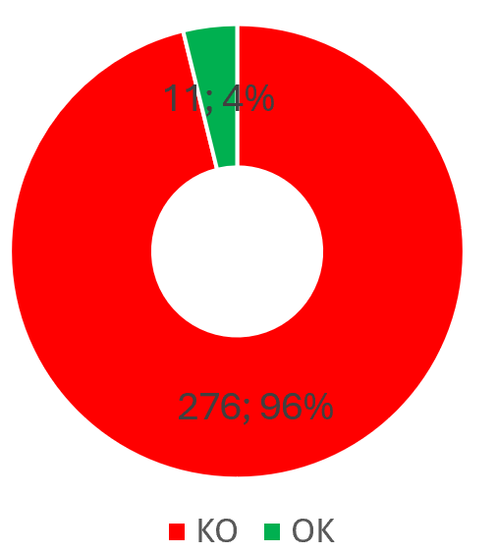
AKS Assessment – Defender profile should be enabled
Benefits: -Identifies misconfigurations in Kubernetes clusters
- Vulnerability assessment for images stored in ACR registries and running in AKS clusters
- Run-time threat protection for nodes and clusters
- Alerts include guidelines to help investigate and mitigate identified threats
Actions:
Enable the Container protection from Defender for Cloud environment settings
Enable the Defender for container components: Agent, Azure Policy, Agentless Discovery, Agentless Vulnerability assessment
Enable the Defender profile on the cluster
Deploy Azure Policy Agent – for data plane security posture
Deploy Defender Agent - for running image vulnerability assessment and workload threat protection
Consider enable and configure Defender for Containers:
How to enable Microsoft Defender for Containers components - Microsoft Defender for Cloud | Microsoft Learn

Slide 18
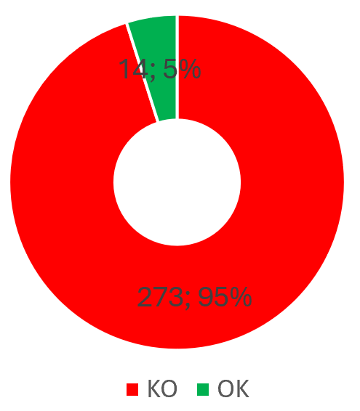
AKS Assessment – Policy add-on should be enabled
Benefits: - Apply at-scale enforcement and safeguards on your clusters in a centralized, consistent manner by leveraging built-in or custom policy
- Azure Policy add-on for Kubernetes allows you to add additional security constraints you'd like to enforce in your cluster and workload architecture (i.e. enforce Pod resource requests and limits or reject a privileged pod)
Actions:
Enable the Azure Policy Add-on the AKS cluster
Leverage built-in Azure Policies or create new definitions
Enable Azure Policy Add-On:
Learn Azure Policy for Kubernetes - Azure Policy | Microsoft Learn

Slide 19
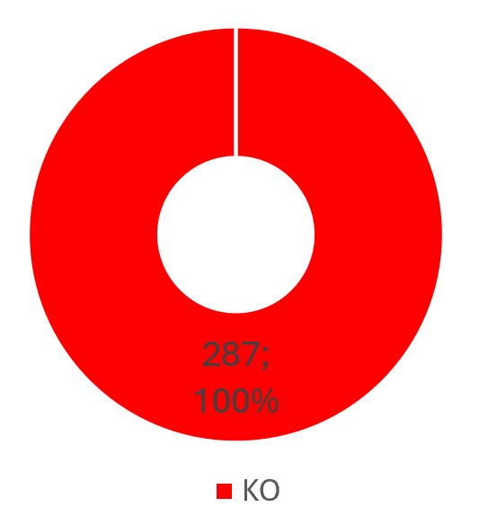
AKS Assessment – KMS should be enabled
Benefits:
-Provide encryption at rest for secrets stored in etcd
-Use a key in Key Vault for etcd encryption
-Bring your own keys
-Rotate the keys in Key Vault
Actions:
Create a KeyVault and a Key
Create a user-assigned managed identity
Assign permission decrypt-encrypt
Update an existing AKS cluster to enable KMS etcd encryption with key vault
Update all secrets for trigger the encryption
Consider create clusters in private mode:
Use Key Management Service (KMS) etcd encryption in Azure Kubernetes Service (AKS) - Azure Kubernetes Service | Microsoft Learn

Slide 20
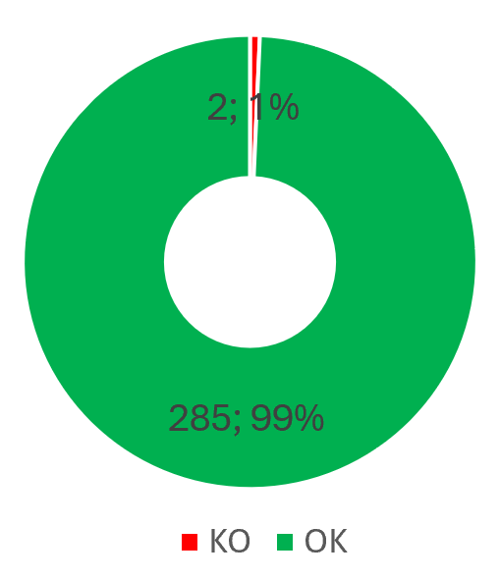
AKS Assessment – RBAC should be enabled
Benefits:
-Enable Role Based Access Control on Kubernetes Resources
Actions:
Update the cluster configuration and enable Kubernetes or Azure RBAC
Assign roles to group/users scoped to cluster, namespace or specific resources
Enable native Kubernetes or Azure RBAC:
Concepts - Access and identity in Azure Kubernetes Services (AKS) - Azure Kubernetes Service | Microsoft Learn

Slide 21
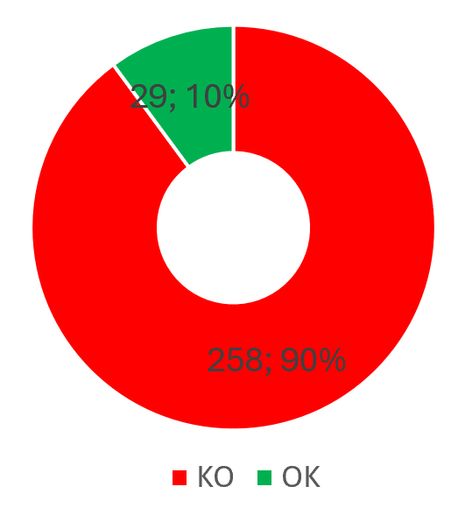
AKS Assessment – Microsoft Entra ID authentication should be enabled
Benefits:
- Use Microsoft Entra ID as Identity Provider
- Authenticate existing groups/users
Actions:
Configure the cluster Authentication
Choose Microsoft Entra ID Authentication
Assign roles to the existing Microsoft Entra ID group/users
Leverage Microsoft Entra identities for access to the cluster or automation (i.e. CI/CD)
Configure the access to your cluster using Entra ID Integration:
Enable managed identity authentication on Azure Kubernetes Service - Azure Kubernetes Service | Microsoft Learn

Slide 22
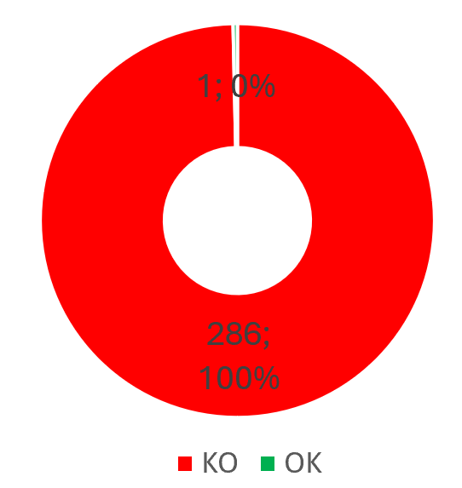
AKS Assessment – Microsoft Entra Workload Identity should be enabled
Benefits:
- Replacement of Pod Identity (deprecated)
- Leverages OIDC federation and Kubernetes native capabilities to federate with any external identity providers
- Associates Micorosoft Entra application credential or managed identity to workloads
- Allows access to Microsoft Entra protected resources (i.e. Graph, KeyVault, etc.)
- Seamless authenticate and access to Azure Resources with MSAL or Azure Identity libraries
Actions:
Enable Workload Identity and OIDC issuer on the cluster
Register a Microsoft Entra application that represents the Workload
Establish federated identity credential
Assign to the identity roles on resources
Configure Service Account
Use the service account with the Pod
Deploy the workload
Configure Microsoft Entra Workload Identities in your cluster:
Use a Microsoft Entra Workload ID on Azure Kubernetes Service (AKS) - Azure Kubernetes Service | Microsoft Learn
Tutorial - Use a workload identity with an application on Azure Kubernetes Service (AKS) - Azure Kubernetes Service | Microsoft Learn

Slide 23
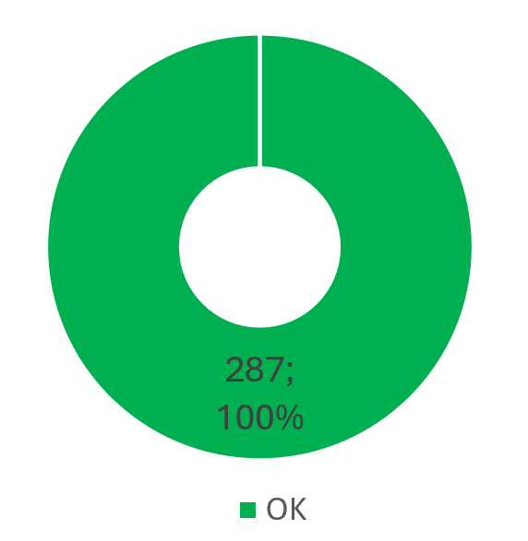
AKS Health Assessment – AAD PodIdentity should not be used
Benefits:
- AAD Pod Identity is deprecated
Actions:
Migrate existing Microsoft Entra pod identity to Entra ID Workload Idenitity
The open source Microsoft Entra pod-managed identity (preview) in Azure Kubernetes Service has been deprecated as of 10/24/2022, and the project will be archived in Sept. 2023. :
Use Microsoft Entra pod-managed identities in Azure Kubernetes Service (Preview) - Azure Kubernetes Service | Microsoft Learn (deprecated)

Slide 24
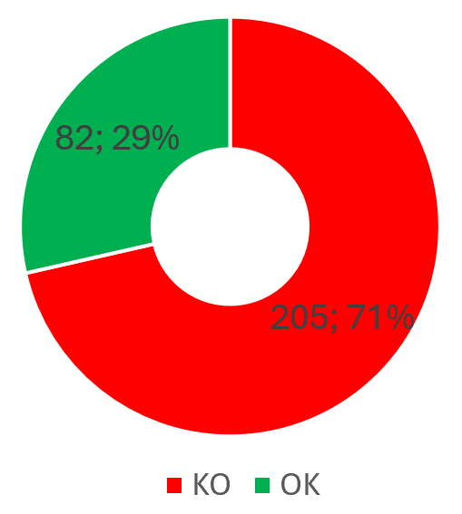
AKS Health Assessment – Leverage Cluster Managed Identity
Benefits:
- Provide AKS cluster a managed identity
- Leverage benefits of managed identity (no secrets)
- Access to resources like Load Balancer, Managed Disks or secret store CSI Driver
Actions:
Enable managed identity on AKS cluster
Add role assignment for managed identity
Assign roles to your cluster using User Managed Identities:
Use a managed identity in Azure Kubernetes Service (AKS) - Azure Kubernetes Service | Microsoft Learn

Slide 25
AKS Assessment – Disable local account
Benefits:
- Disable non-auditable users
- Leverage modern authentication
Actions:
Disable local account
Enable Microsoft Entra ID/Kubernetes RBAC
Disable local account:
Manage local accounts with AKS-managed Microsoft Entra integration - Azure Kubernetes Service | Microsoft Learn

Slide 26
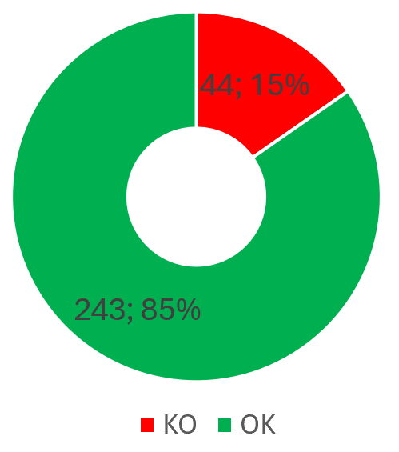
AKS Assessment – Container Insights should be enabled
Benefits:
- Identifying containers running on each node and their processor and memory utilization
- Identify capacity needs and determine the maximum load that the cluster can sustain
- Access live container logs and metrics generated by the container engine to help with troubleshooting
- Configure alerts to proactively notify you or record when CPU and memory utilization on nodes or containers exceed your thresholds
- Easy on-board experience
- Built-in visualizations
- Data collection presets (cost-saving, verbose)
Actions:
Identify a Log Analytics Workspace
Enable Container Insights
Optionally Integrate with managed Prometheus or Grafana
Identify metric/logs alert rules for your worklad
Configure monitoring for your clusters:
Enable Container insights for Azure Kubernetes Service (AKS) cluster - Azure Monitor | Microsoft Learn

Slide 27
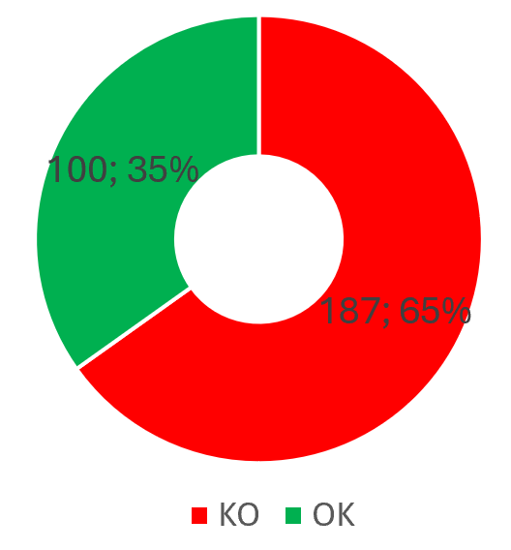
AKS Assessment – Diagnostic Settings should be enabled
Benefits:
- Enable AKS Cluster platform logs
- Monitor cluster control plane components including API Server, Audit, etc.
Actions:
Identify a Log Analytics Workspace
Configure diagnostic settings
Select Log Categories (i.e. Kubernetes API Server or Kubernetes Audit)
Configure Diagnostic Settings for your clusters:
Monitor Azure Kubernetes Service (AKS) - Azure Kubernetes Service | Microsoft Learn

Slide 28
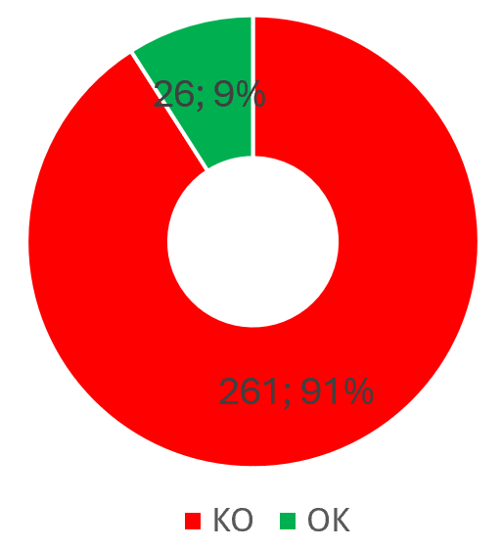
AKS Assessment – Availability zones should be used
Benefits:
- Cluster nodes span multiple zones
- Node pool can continue operating even if a single zone has gone down
- Applications can continue to be available even if there's a physical failure in a single datacenter if orchestrated to tolerate failure of a subset of nodes
Actions:
Recreate the node pool
Chose up to 3 availability zone
Set a nodepool count to a minimum number according the availability zones
Increase replica of pods of your workload so that can span nodes on different availability zones
Make sure the application is designed to tolerate failure of a subset of nodes
Consider recreate production clusters using Availability Zones:
Use availability zones in Azure Kubernetes Service (AKS) - Azure Kubernetes Service | Microsoft Learn

Slide 29
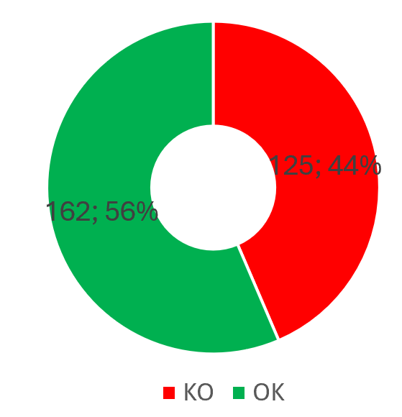
AKS Assessment – Uptime SLA should be enabled
Benefits:
- Clusters with up to 5,000 nodes
- SLA feature guarantees 99.95% availability of the Kubernetes API server endpoint for clusters using Availability Zones, and 99.9% of availability for clusters that aren't using Availability Zones.
Actions:
Configure the AKS pricing tier from “Free” to “Standard”
Consider upgrade production clusters from free tier to standard tier:
Azure Kubernetes Service (AKS) Free and Standard pricing tiers for cluster management - Azure Kubernetes Service | Microsoft Learn

Slide 30
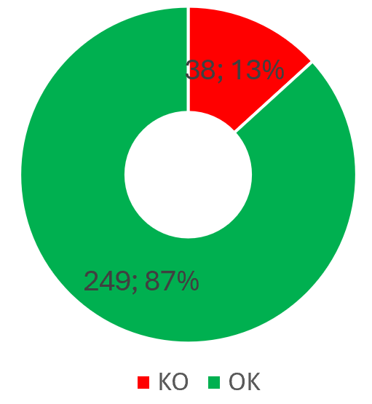
AKS Assessment - Control plane and node pools version should not be outdated
Benefits:
- Leverage support windows of 1 year (last 3 versions)
- Consider additional 1 year of LTS support from AKS with premium tier
Actions:
Check breaking changes from changelog of new version of Kubernetes
Test your workload on AKS cluster with the upgrade
Upgrade Cluster Configuration and nodepools to a supported version of Kuberenetes
Consider upgrade unsupported clusters – Check supportability:
Supported Kubernetes versions in Azure Kubernetes Service (AKS). - Azure Kubernetes Service | Microsoft Learn

Slide 31
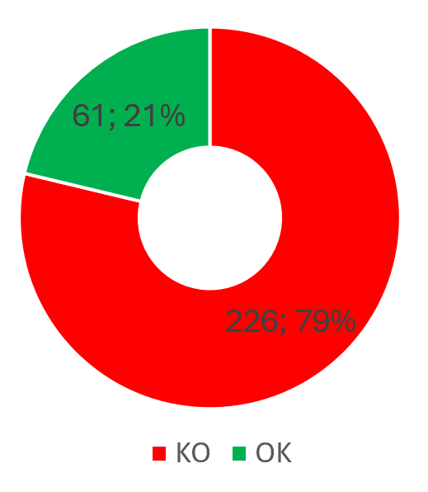
AKS Assessment – Cluster should have at least one system and one user node pool
Benefits:
- Isolate crytical system pods (running on system nodepool) from application pods (running on user nodepool)
- Dedicate specific user nodepool that fits your application requirements: VM Size and instance count
Actions:
Create a user node pool
Modify deployment (YAML, Heml, CI/CD) of your application to target the new node pool (i.e. using labels)
Separate System node pool from workload User node pools:
Use system node pools in Azure Kubernetes Service (AKS) - Azure Kubernetes Service | Microsoft Learn

Slide 32
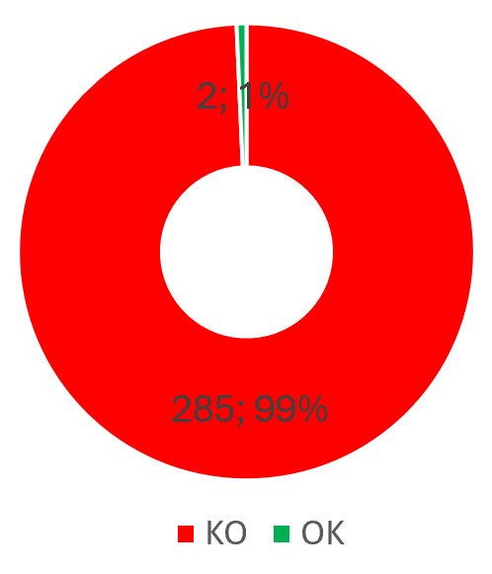
AKS Assessment – Azure Overlay network should be used
Benefits:
- Prevent IP address exhaustion when Azure CNI is used and you need to scale the workload
- Limited IP address space in the VNET
Actions:
Make sure that most of the pod communication happens whitin the cluster
Make sure you don’t need AKS features, such as virtual nodes
Upgrade the cluster to the Azure CNI Overlay network plugin
Configure Azure CNI Overlay network plugin:
Configure Azure CNI Overlay networking in Azure Kubernetes Service (AKS) - Azure Kubernetes Service | Microsoft Learn

Slide 33
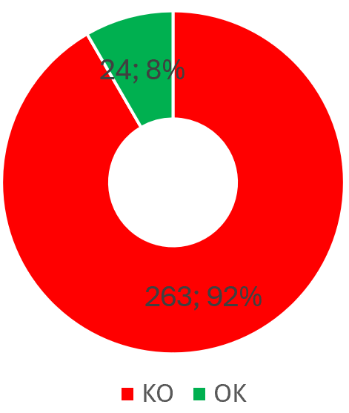
AKS Assessment – Leverage Ephemeral OS Disk
Benefits:
- Ephemeral OS disks are created on the local virtual machine (VM) storage and not saved to the remote Azure Storage, as when using managed OS disks
- Ideal for stateless applications and workloads
- Lower latency, similar to a temporary disk
Actions:
Configure a new nodepool to use Ephemeral OS disk
Migrate the workload on the new nodepool
Configure the cluster to use ephemeral OS disks:
Cluster configuration in Azure Kubernetes Services (AKS) - Azure Kubernetes Service | Microsoft Learn

Slide 34
Next steps
Insert here next steps

Slide 35
Thank you

